Slide 1
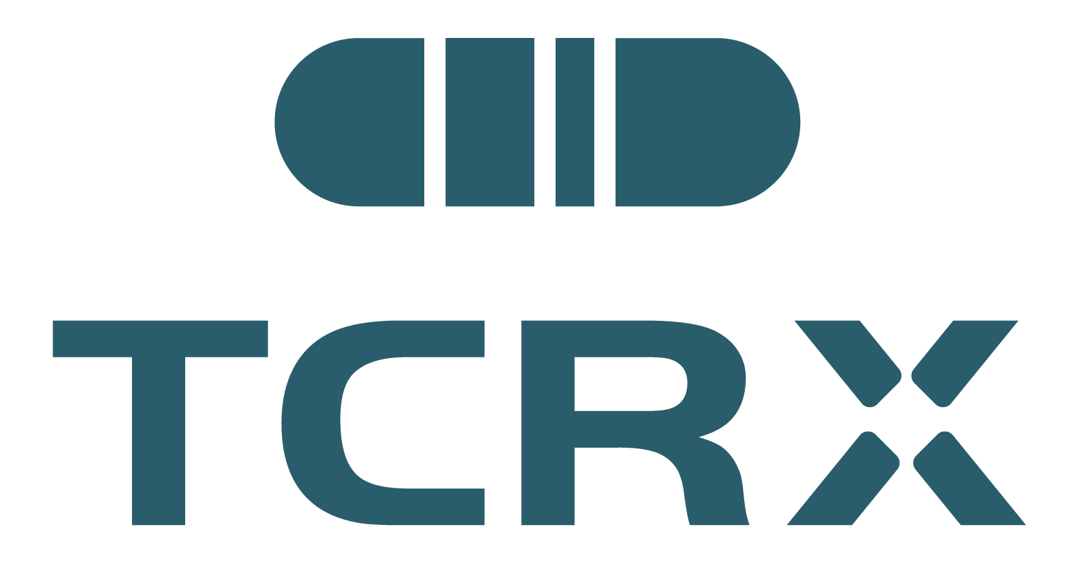


vitatresgene teprelentivec
VIKETAI
Upon receipt store
refrigerated at
−90°C to −60°C
Suspension for infusion
Rx ONLY
Please refer to leaflet before administering.
Indication: for the treatment of adults with MAGE-A4 positive solid tumors.
Active Ingredient: vitatresgene teprelentivec
Recommend Dose: The recommended dose is 1×10⁸ ~ 6×10⁸ TU as a single infusion.
See enclosed prescribing information for dosage and directions for use.
Manufacturer: Pharma Cent Mongolia LLC
Address: Khan Uul district, 11 district, Zaisan (17023)， Dunjingarav street, building # 18, block A, floor 7,Ulaanbaatar, Mongolia
Reg No.:
Batch No.:
Mfg. Date:
Exp. Date:
DO NOT SHAKE
DO NOT REFREEZE
KEEP UPRIGHT
DO NOT TIP
Pharma Cent
Mongolia LLC
Dispense with Medication Guide
vitatresgene teprelentivec
VIKETAI
Upon receipt store
refrigerated at
−90°C to −60°C
Suspension for infusion
Rx ONLY
Please refer to leaflet before administering.
Indication: for the treatment of adults with MAGE-A4 positive solid tumors.
Active Ingredient: vitatresgene teprelentivec
Recommend Dose: The recommended dose is 1×10⁸ ~ 6×10⁸ TU as a single infusion.
See enclosed prescribing information for dosage and directions for use.
Manufacturer: Pharma Cent Mongolia LLC
Address: Khan Uul district, 11 district, Zaisan (17023)， Dunjingarav street, building # 18, block A, floor 7,Ulaanbaatar, Mongolia
Reg No.:
Batch No.:
Mfg. Date:
Exp. Date:
DO NOT SHAKE
DO NOT REFREEZE
KEEP UPRIGHT
DO NOT TIP
Pharma Cent
Mongolia LLC
Dispense with Medication Guide

Slide 2
auracabtagene teprelentivec
CARENTAI
Upon receipt store
refrigerated at
−90°C to −60°C
Suspension for infusion
Rx ONLY
Please refer to leaflet before administering.
Indication: for the treatment of adults with B-cell lymphoblastic leukemia, B-cell lymphoma and autoimmune disease.
Active Ingredient: auracabtagene teprelentivec
Recommend Dose: The recommended dose is 5×10⁷ ~ 6×10⁸ TU as a single infusion.
See enclosed prescribing information for dosage and directions for use.
Manufacturer: Pharma Cent Mongolia LLC
Address: Khan Uul district, 11 district, Zaisan (17023)， Dunjingarav street, building # 18, block A, floor 7,Ulaanbaatar, Mongolia
Reg No.:
Batch No.:
Mfg. Date:
Exp. Date:
DO NOT SHAKE
DO NOT REFREEZE
KEEP UPRIGHT
DO NOT TIP
Pharma Cent
Mongolia LLC
Dispense with Medication Guide
auracabtagene teprelentivec
CARENTAI
Upon receipt store
refrigerated at
−90°C to −60°C
Suspension for infusion
Rx ONLY
Please refer to leaflet before administering.
Indication: for the treatment of adults with B-cell lymphoblastic leukemia, B-cell lymphoma and autoimmune disease.
Active Ingredient: auracabtagene teprelentivec
Recommend Dose: The recommended dose is 5×10⁷ ~ 6×10⁸ TU as a single infusion.
See enclosed prescribing information for dosage and directions for use.
Manufacturer: Pharma Cent Mongolia LLC
Address: Khan Uul district, 11 district, Zaisan (17023)， Dunjingarav street, building # 18, block A, floor 7,Ulaanbaatar, Mongolia
Reg No.:
Batch No.:
Mfg. Date:
Exp. Date:
DO NOT SHAKE
DO NOT REFREEZE
KEEP UPRIGHT
DO NOT TIP
Pharma Cent
Mongolia LLC
Dispense with Medication Guide

